Slide 1
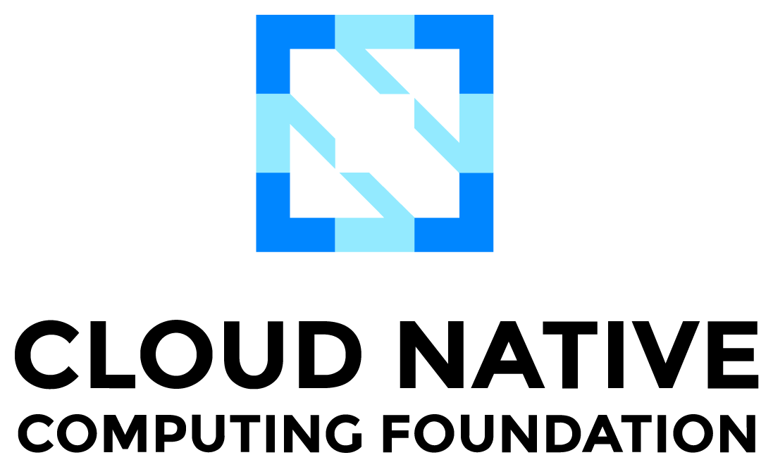


Crossplane: K8s as Universal Control Plane

Slide 2


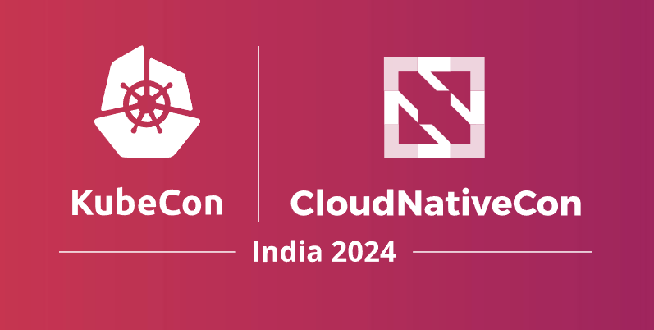
Utkarsh Mishra Sr. Site Reliability Engineer @ Mitra AI, Ex-Tata Elxsi Open-Source Contributor to OSM by ETSI
I will be there!
LinkedIn@utkarsh-mishra-um10
Github@Sir-gits-a-lot
#KubeCon #CloudNativeCon
#TEAMCLOUDNATIVE
#CLOUDNATIVEBHARAT

Slide 3

01
Problem Statement
AGENDA
02
The Infrastructure as Data Movement
03
Crossplane Intro
04
Use Cases

Slide 4



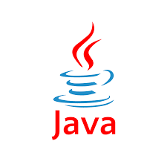
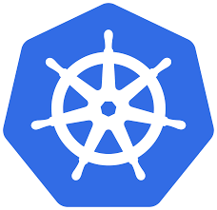

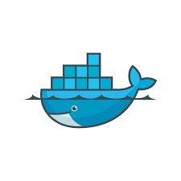





THE Problem Statement
Prod is down!!!
Biz Team
Dev Team
Ops Team
Wall of Confusion
“Works on my local”
Working till late to resolve the issue.
RCA: Somebody used kubectl or AWS Management Console.

Slide 5

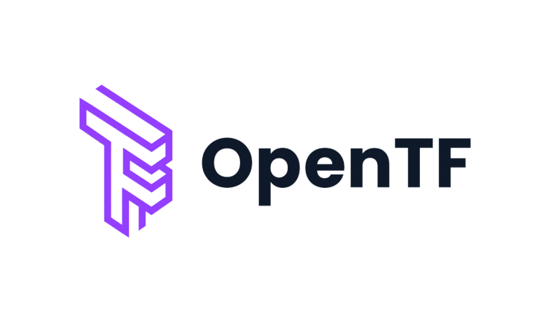
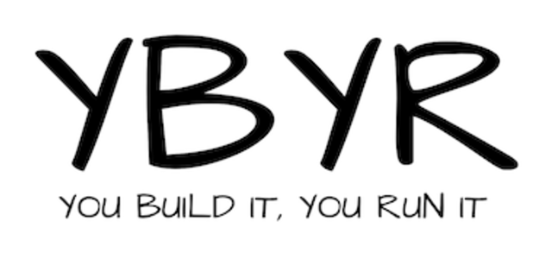

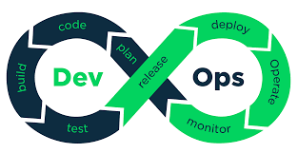

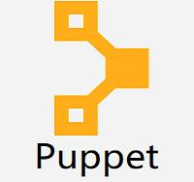
Infrastructure as Code: The Buzz in DevOps

Slide 6

Infrastructure as Data: the Paradigm Shift

Slide 7
Crossplane: intro
Crossplane is a cloud native Low-Code control plane framework developed by Upbound, currently an Incubating CNCF project, applied for graduation.
Open source: Crossplane is donated to CNCF and maintained by the crossplane community mostly used but not limited to as an Infrastructure-as-Data tool.
Shift-left Approach: Crossplane enables Ops team to build interfaces for the dev teams to claim and build Platforms of their own to run applications.
Integration with K8s Ecosystem: Since Crossplane leverages CRDs and controllers, it integrates with K8s ecosystem easily especially GitOps.
Active Reconciliation: Fire-and-track over Fire N’ Forget that traditional IAC tools have promoted which neglects day two headaches.
More than Declarative: Define your opinions not worrying about implementations. e.g. “I need a cluster in aws/azure/gcp to run my application”.

Slide 8
Multi-cloud support: Crossplane has official providers for 3 major clouds and some other providers like Openstack are also available from the community.
Easy Packaging and distribution: Crossplane Configurations can be easily packaged and distributed to any OCI-compatible registry which enables DRY principles and brings the notion of catalogue.
Platform API: Crossplane helps to build a self-service, claimable API for teams to consume with guardrails and policies implemented by the Ops teams e.g., Application needs K8s clusters as platforms, Databases for storage, Elastic Search for Observability, Serverless for Compute requirements, Machine Learning services, etc.
Ephemerality over Stateful: If infrastructure can be defined in config. File. It can be created again.
Ops team can build compositions with different cloud vendors say, Clusters from AWS, Storage from Azure and MLOps from GCP all clubbed into 1 API exposed for dev teams to consume.
Xfn: Composite Resource Functions give crossplane compositions freedom to introduce variability and Runtime decision making. All Xfns run in rootless function containers as sidecar containers to the crossplane core pod. Communication is done via gRPC.

Slide 9
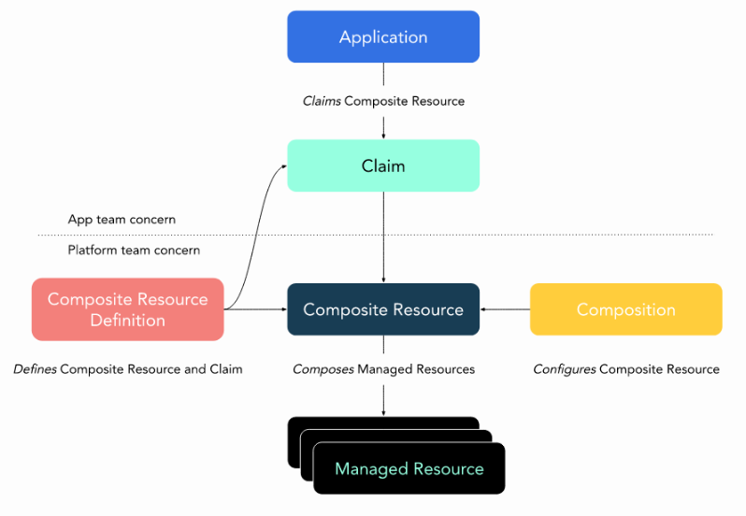

Slide 10

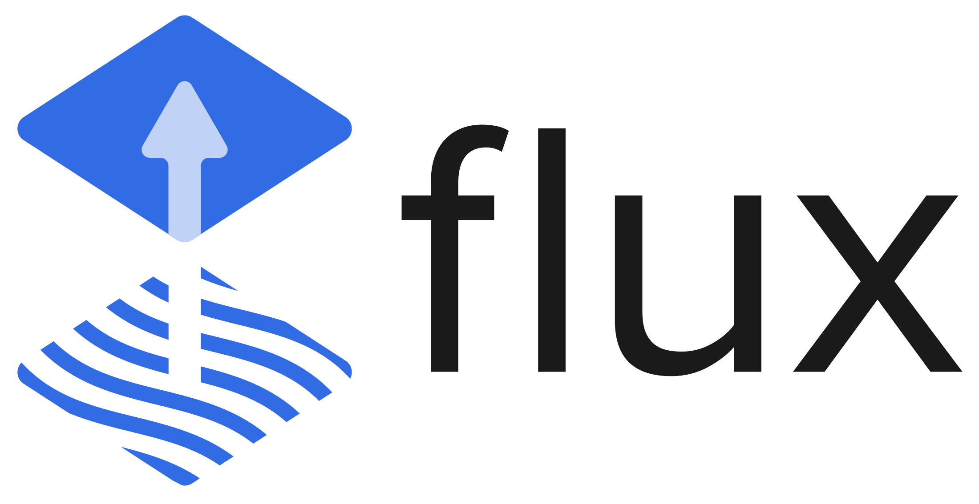

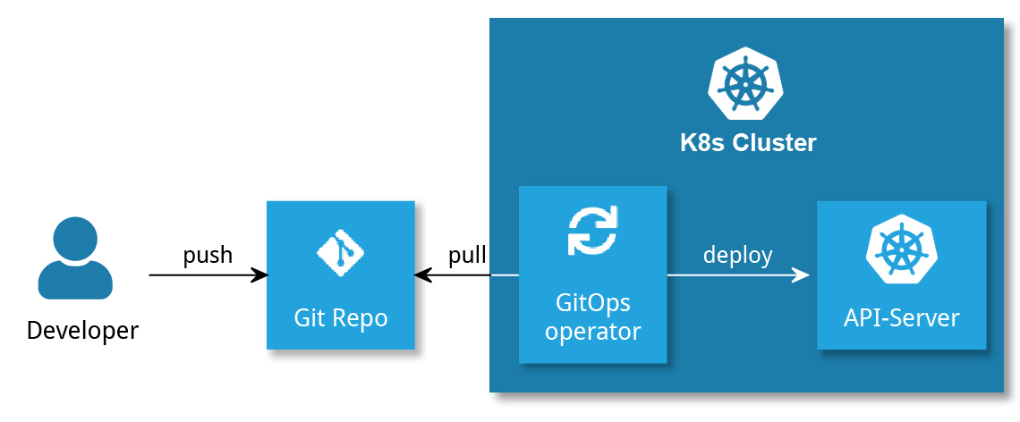

GitOps In a Nutshell
GitOps is a way to implement WYSIWYG

Slide 11
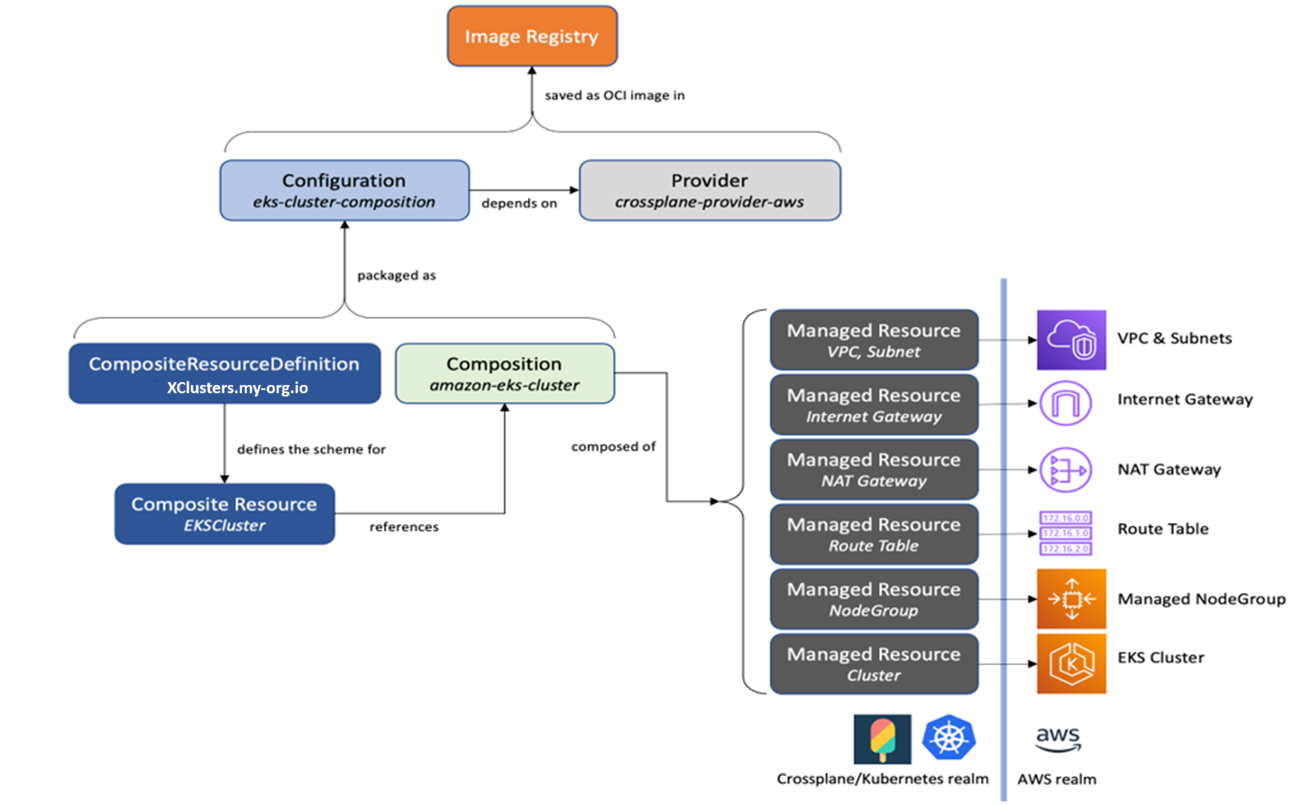
Clusters as a Service
Composite f(x)
Use Case 1

Slide 12

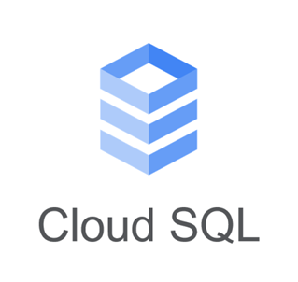
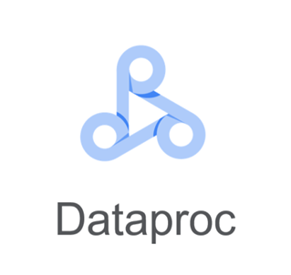
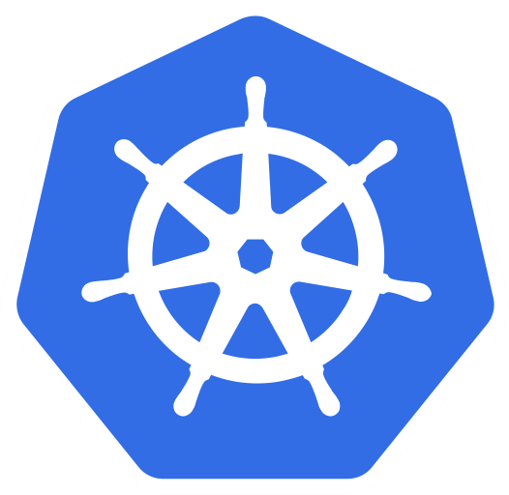




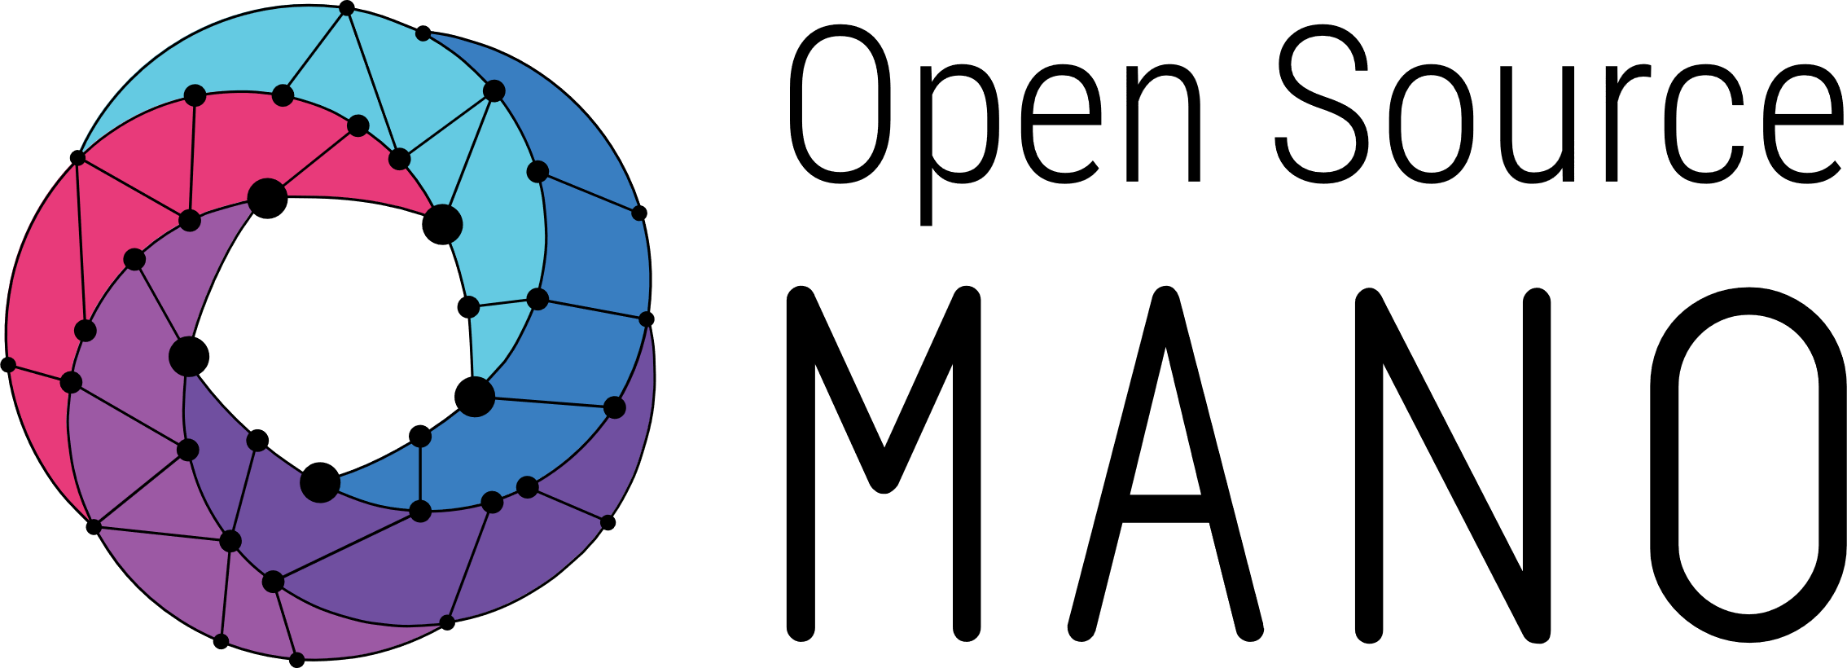


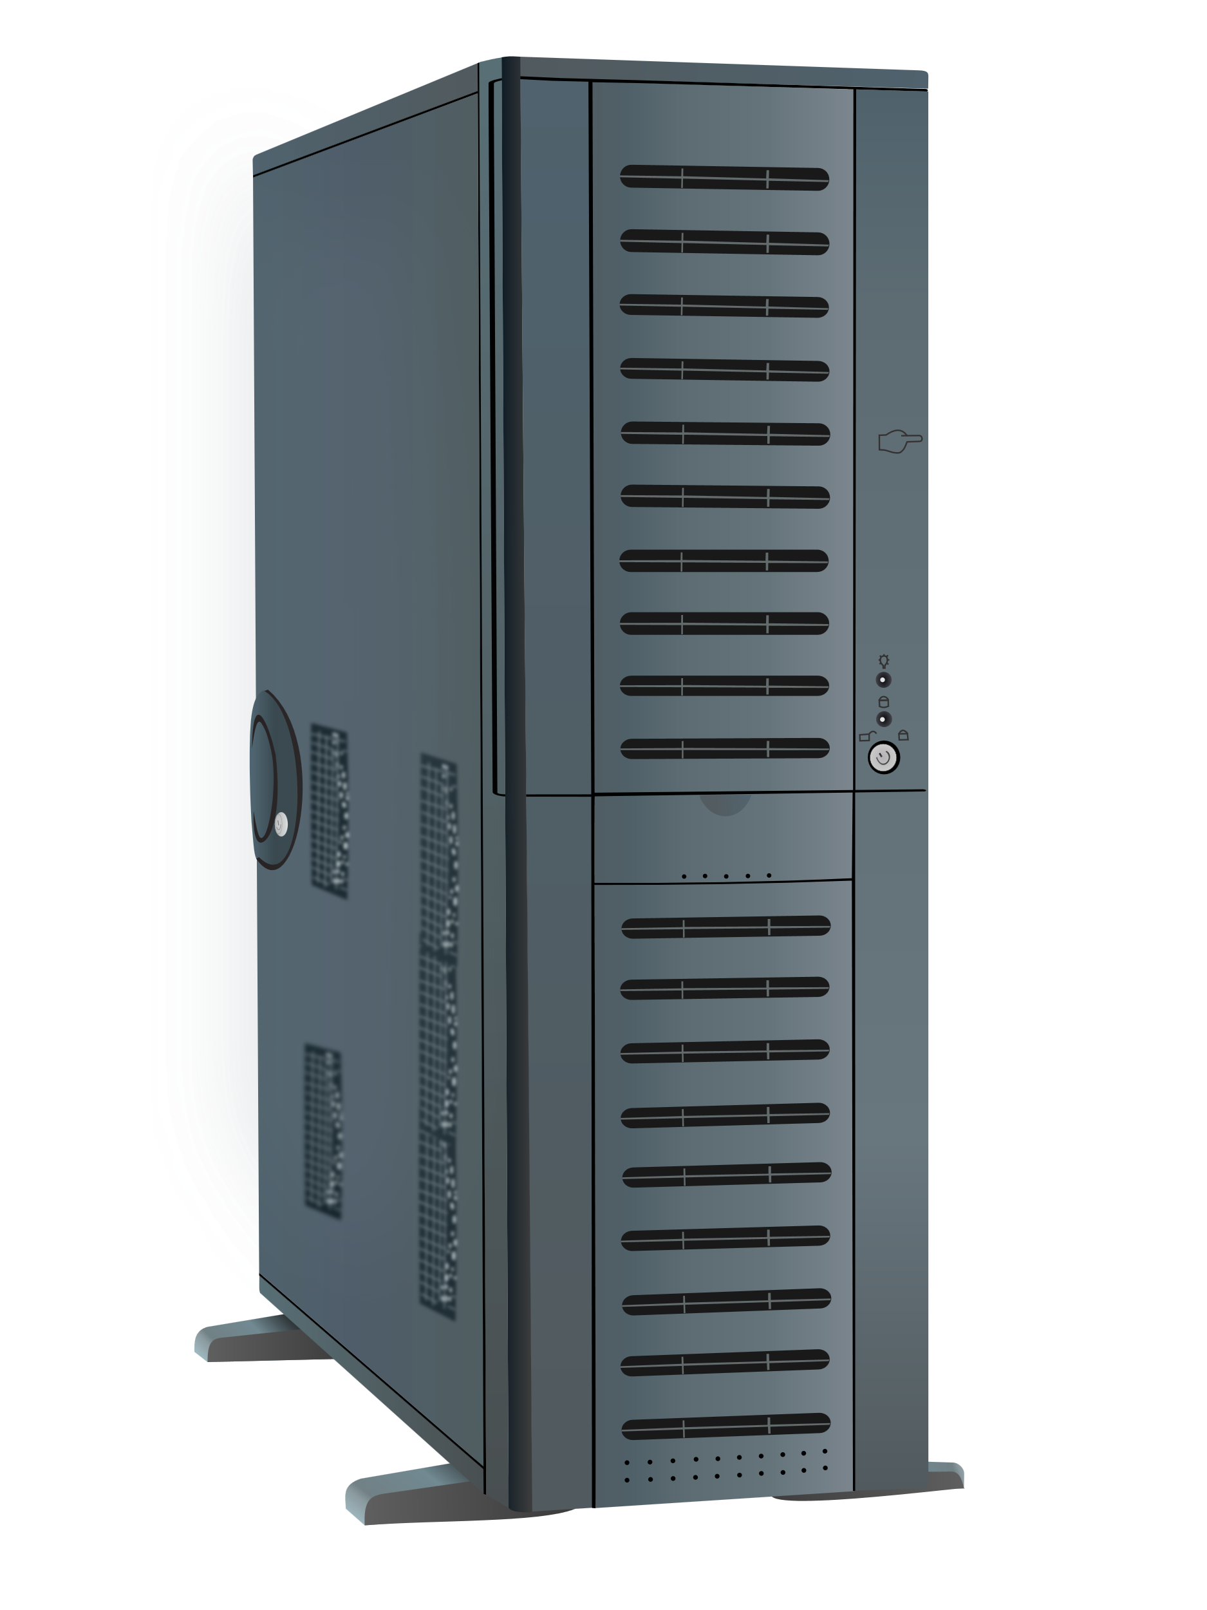

Use case 2: OSM redefined as a generalized orchestrator
Infrastructure: VMs, K8s clusters
Platforms: PaaS
Services: NF and NS
GKE
AKS
HDInsight
Cosmos DB
OSM NBI
SageMaker
VM
VM
VM
RDS
EKS
VM
VM
VM
VM
VM
VM

Slide 13
Long Live Cloud native!

Slide 14
Thanks, CNCF Pune
Open for Q&A…

